Slide 1
Statistics for the Social Sciences
Psychology 340
Fall 2013
Thursday, October 10
Analysis of Variance (ANOVA)

Slide 2
Exam Results (with 5 point curve)
Mean = 73.98
Trimmed Mean = 76.18
Standard Deviation = 15.98
Trimmed SD = 11.81
Distribution:
AAA
BBBBBB
CCCCCCCCCC
DDD
FFF

Slide 3
General Feedback
Most people did a good job knowing which test to do, and with following the four steps of hypothesis testing.
Great job with independent-samples t-test (by hand)
A few students who have come in for help did better on this test than the last test – Good Job!
Most people did better on Central Limit Theorem question, but several still lost points on this. Expect to see it again on future exams (as well as questions about why it is important).
Most people missed question about power on p. 3., and many missed question about Type I and Type II error and alpha and beta on p. 1. Expect to see more questions on these concepts.
Lots of confusion re: Levene’s Test. Expect to see more questions on this.

Slide 4
New Topic: ANOVA
We will start to move a bit more slowly now.
Homework (due Tuesday):
Chapter 12, Questions: 1, 2, 7, 8, 9, 10, 12

Slide 5
Outline (for next two classes)
Basics of ANOVA
Why
Computations
ANOVA in SPSS
Post-hoc and planned comparisons
Assumptions
The structural model in ANOVA

Slide 6
Outline (today)
Basics of ANOVA
Why
Computations
ANOVA in SPSS
Post-hoc and planned comparisons
Assumptions
The structural model in ANOVA

Slide 7
Example
Effect of knowledge of prior behavior on jury decisions
Dependent variable: rate how innocent/guilty
Independent variable: 3 levels
Criminal record
Clean record
No information (no mention of a record)

Slide 8
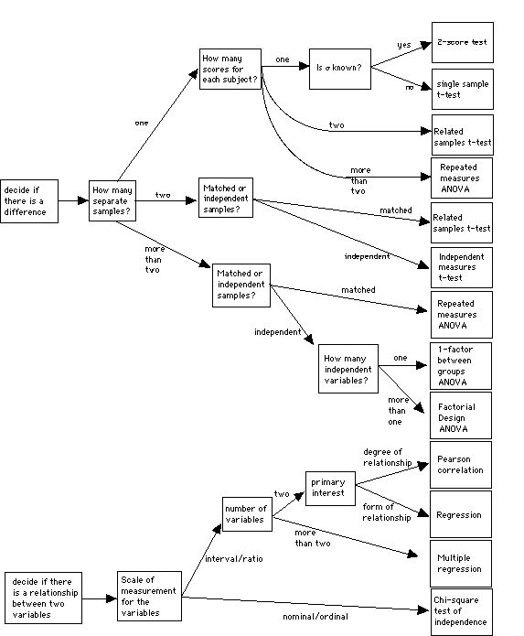
Statistical analysis follows design
The 1 factor between groups ANOVA:
More than two
Independent & One score per subject
1 independent variable

Slide 9
Analysis of Variance
Generic test statistic
M_{B}
M_{C}
M_{A}
Criminal record | Clean record | No information
10 | 5 | 4
7 | 1 | 6
5 | 3 | 9
10 | 7 | 3
8 | 4 | 3
M_{A} = 8.0 | M_{B} = 4.0 | M_{C} = 5.0
More than two groups
Now we can’t just compute a simple difference score since there are more than one difference

Slide 10
Analysis of Variance
Test statistic
Observed variance
F-ratio =
Variance from chance
M_{B}
M_{C}
M_{A}
Criminal record | Clean record | No information
10 | 5 | 4
7 | 1 | 6
5 | 3 | 9
10 | 7 | 3
8 | 4 | 3
M_{A} = 8.0 | M_{B} = 4.0 | M_{C} = 5.0
More than two groups
Need a measure that describes several difference scores
Variance
Variance is essentially an average squared difference

Slide 11
Testing Hypotheses with ANOVA
Hypothesis testing: a four step program
Step 1: State your hypotheses
Null hypothesis (H₀)
All of the populations all have same mean
Alternative hypotheses (H_{A})
Not all of the populations all have same mean
There are several alternative hypotheses
We will return to this issue later

Slide 12
Testing Hypotheses with ANOVA
Hypothesis testing: a four step program
Step 1: State your hypotheses
Step 2: Set your decision criteria
Step 3: Collect your data & compute your test statistics
Compute your degrees of freedom (there are several)
Compute your estimated variances
Compute your F-ratio
Step 4: Make a decision about your null hypothesis
Additional tests
Reconciling our multiple alternative hypotheses

Slide 13
Step 3: Computing the F-ratio
Analyzing the sources of variance
Describe the total variance in the dependent measure
Why are these scores different?
Two sources of variability
Within groups
Between groups
M_{B}
M_{C}
M_{A}

Slide 14
Step 3: Computing the F-ratio
Within-groups estimate of the population variance
Estimating population variance from variation from within each sample
Not affected by whether the null hypothesis is true
Different people
within each group
give different ratings
M_{B}
M_{C}
M_{A}

Slide 15
Step 3: Computing the F-ratio
Between-groups estimate of the population variance
Estimating population variance from variation between the means of the samples
Is affected by whether or not the null hypothesis is true
There is an effect
of the IV, so the
people in different
groups give different
ratings
M_{B}
M_{C}
M_{A}

Slide 16
Partitioning the variance
Note: we will start
with SS, but will
get to variance
Total variance
Stage 1
Between groups
variance
Within groups
variance

Slide 17
Partitioning the variance
Total variance
Criminal record | Clean record | No information
10 | 5 | 4
7 | 1 | 6
5 | 3 | 9
10 | 7 | 3
8 | 4 | 3
Basically forgetting about separate groups
Compute the Grand Mean (GM)
Compute squared deviations from the Grand Mean

Slide 18
Partitioning the variance
Total variance
Stage 1
Between groups
variance
Within groups
variance

Slide 19
Partitioning the variance
Within groups variance
Criminal record | Clean record | No information
10 | 5 | 4
7 | 1 | 6
5 | 3 | 9
10 | 7 | 3
8 | 4 | 3
M_{A} = 8.0 | M_{B} = 4.0 | M_{C} = 5.0
Basically the variability in each group
Add up the SS from all of the groups

Slide 20
Partitioning the variance
Total variance
Stage 1
Within groups
variance
Between groups
variance

Slide 21
Partitioning the variance
Between groups variance
Criminal record | Clean record | No information
10 | 5 | 4
7 | 1 | 6
5 | 3 | 9
10 | 7 | 3
8 | 4 | 3
M_{A} = 8.0 | M_{B} = 4.0 | M_{C} = 5.0
Basically how much each group differs from the Grand Mean
Subtract the GM from each group mean
Square the diffs
Weight by number of scores

Slide 22
Partitioning the variance
Total variance
Stage 1
Between groups
variance
Within groups
variance

Slide 23
Partitioning the variance
Now we return to
variance. But, we
call it
Mean Squares (MS)
Total variance
Recall:
Stage 1
Between groups
variance
Within groups
variance

Slide 24
Partitioning the variance
Mean Squares (Variance)
Between groups
variance
Within groups
variance

Slide 25
Step 4: Computing the F-ratio
The F ratio
Ratio of the between-groups to the within-groups population variance estimate
Observed variance
F-ratio =
Variance from chance
The F distribution
The F table
Do we reject or fail
to reject the H₀?

Slide 26
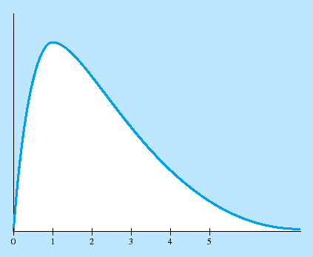
Carrying out an ANOVA
The F distribution
The F table
Need two df’s
df_{between} (numerator)
df_{within} (denominator)
Values in the table correspond to critical F’s
Reject the H₀ if your computed value is greater than or equal to the critical F
Separate tables for 0.05 & 0.01

Slide 27
Carrying out an ANOVA
The F table
Need two df’s
df_{between} (numerator)
df_{within} (denominator)
Values in the table correspond to critical F’s
Reject the H₀ if your computed value is greater than or equal to the critical F
Separate tables for 0.05 & 0.01
Do we reject or fail
to reject the H₀?
From the table (assuming 0.05) with 2 and 12 degrees of freedom the critical F = 3.89.
So we reject H₀ and conclude that not all groups are the same

Slide 28
Computational Formulas
T = Group Total
G = Grand Total
Criminal record | Clean record | No information
10 | 5 | 4
7 | 1 | 6
5 | 3 | 9
10 | 7 | 3
8 | 4 | 3
T_{A} = 40 | T_{B} = 20 | T_{C} = 25
 | G=85

Slide 29
Computational Formulas
Criminal record | Clean record | No information
10 | 5 | 4
7 | 1 | 6
5 | 3 | 9
10 | 7 | 3
8 | 4 | 3
T_{A} = 40 | T_{B} = 20 | T_{C} = 25
 | G=85

Slide 30
Computational Formulas
Criminal record | Clean record | No information
10 | 5 | 4
7 | 1 | 6
5 | 3 | 9
10 | 7 | 3
8 | 4 | 3
T_{A} = 40 | T_{B} = 20 | T_{C} = 25
 | G=85

Slide 31
Computational Formulas
Criminal record | Clean record | No information
10 | 5 | 4
7 | 1 | 6
5 | 3 | 9
10 | 7 | 3
8 | 4 | 3
T_{A} = 40 | T_{B} = 20 | T_{C} = 25
 | G=85

Slide 32
Computational Formulas
Criminal record | Clean record | No information
10 | 5 | 4
7 | 1 | 6
5 | 3 | 9
10 | 7 | 3
8 | 4 | 3
T_{A} = 40 | T_{B} = 20 | T_{C} = 25
 | G=85

Slide 33
Partitioning the variance
Total variance
Stage 1
Between groups
variance
Within groups
variance

Slide 34
$H_{0}:μ_{A}=μ_{B}=μ_{C}=μ_{DF}$
3:
4:
Conclusion: F_{Obs} > F_{Critical} (p < .05) so Reject H₀ and conclude that # of absences is not equal among people earning different grades.

Slide 35
Next time
Basics of ANOVA
Why
Computations
ANOVA in SPSS
Post-hoc and planned comparisons
Assumptions
The structural model in ANOVA

Slide 36
Assumptions in ANOVA
Populations follow a normal curve
Populations have equal variances

Slide 37
Planned Comparisons
Reject null hypothesis
Population means are not all the same
Planned comparisons
Within-groups population variance estimate
Between-groups population variance estimate
Use the two means of interest
Figure F in usual way

Slide 38
1 factor ANOVA
M_{A}
M_{B}
M_{C}
Null hypothesis:
H₀: all the groups are equal
The ANOVA tests this one!!
M_{A} = M_{B} = M_{C}
Alternative hypotheses
H_{A}: not all the groups are equal
M_{A} ≠ M_{B} ≠ M_{C}
M_{A} ≠ M_{B} = M_{C}
M_{A} = M_{B} ≠ M_{C}
M_{A} = M_{C} ≠ M_{B}

Slide 39
1 factor ANOVA
Planned contrasts and post-hoc tests:
- Further tests used to rule out the different Alternative hypotheses
M_{A} ≠ M_{B} ≠ M_{C}
Test 1: A ≠ B
M_{A} = M_{B} ≠ M_{C}
Test 2: A ≠ C
M_{A} ≠ M_{B} = M_{C}
Test 3: B = C
M_{A} = M_{C} ≠ M_{B}

Slide 40
Planned Comparisons
Simple comparisons
Complex comparisons
Bonferroni procedure
Use more stringent significance level for each comparison

Slide 41
Controversies and Limitations
Omnibus test versus planned comparisons
Conduct specific planned comparisons to examine
Theoretical questions
Practical questions
Controversial approach

Slide 42
ANOVA in Research Articles
F(3, 67) = 5.81, p < .01
Means given in a table or in the text
Follow-up analyses
Planned comparisons
Using t tests

Slide 43
1 factor ANOVA
Reporting your results
The observed difference
Kind of test
Computed F-ratio
Degrees of freedom for the test
The “p-value” of the test
Any post-hoc or planned comparison results
“The mean score of Group A was 12, Group B was 25, and Group C was 27. A 1-way ANOVA was conducted and the results yielded a significant difference, F(2,25) = 5.67, p < 0.05. Post hoc tests revealed that the differences between groups A and B and A and C were statistically reliable (respectively t(1) = 5.67, p < 0.05 & t(1) = 6.02, p <0.05). Groups B and C did not differ significantly from one another”

Slide 44
The structural model and ANOVA
The structural model is all about deviations
Score
(X)
Group mean
(M)
Grand mean
(GM)
Score’s deviation
from group mean
(X-M)
Group’s mean’s
deviation from
grand mean
(M-GM)
Score’s deviation from grand mean
(X-GM)

